Slide 1

Task 1: Explanatory Data Analysis
Overall Transaction
POS transaction
Age group
analysis
Gender
analysis
Age Group & Gender analysis
Prepared by: Megan Ng

Slide 2
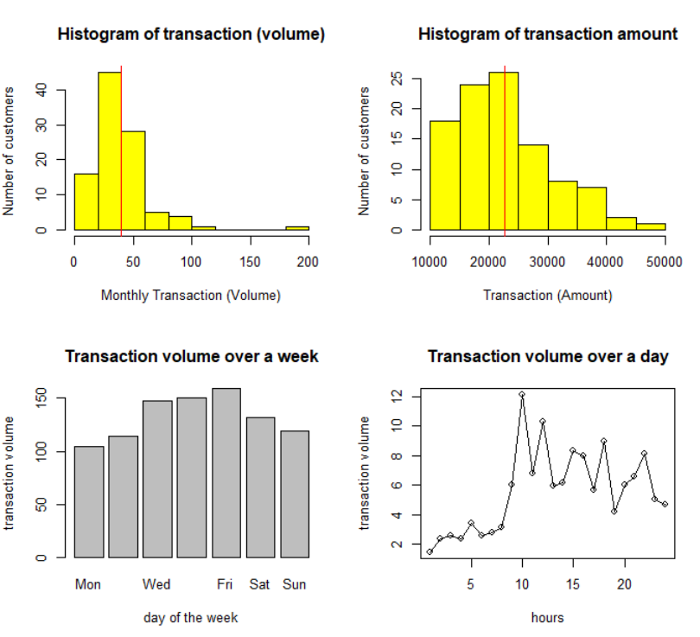
From Figure 1, customers make 40 transactions (red vertical line) monthly on average
From Figure 2, average amount of transaction is 2263 (red vertical line) over the 3 months
Figure 3 implies high transaction volume on Friday
From Figure 4, transaction volume is highest at 9:00 – 10:00
Figure 1
Figure 2
Figure 3
Figure 4

Slide 3
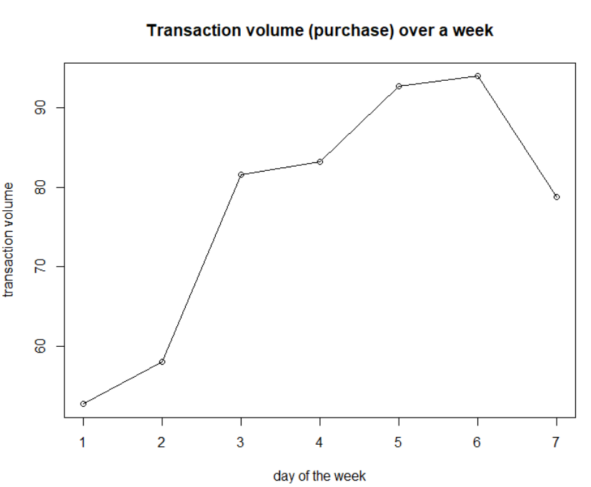
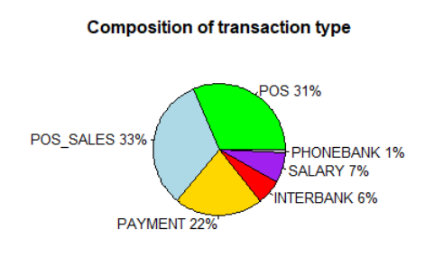
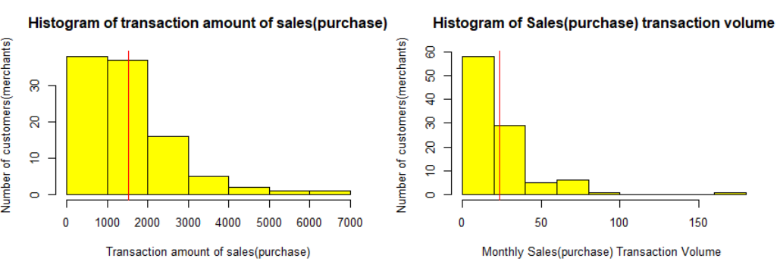
From pie chart, POS has highest composition (64%) of total transaction, hence perform deeper analysis into it
Transaction volume for POS is highest on Saturday
Average amount of POS transaction is about 1530 (red vertical line on histogram)
Monthly average transactions for each customer is about 23 (red vertical line on histogram)

Slide 4
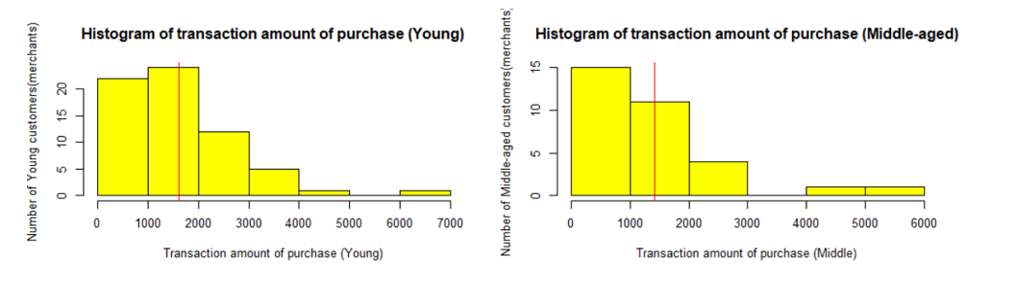
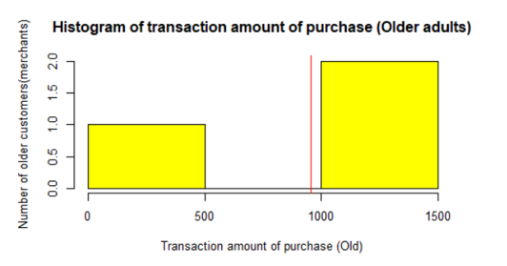
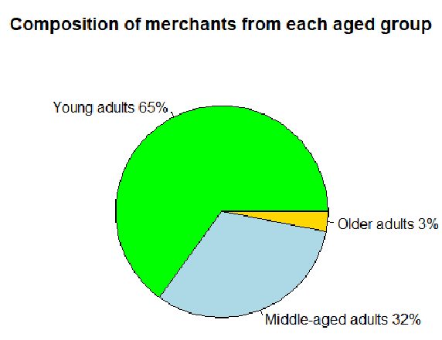
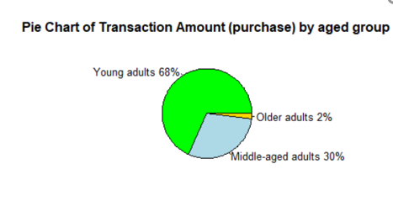
POS transaction analysis by age group
Young adults (18-35 years old) Middle-aged adults(36-55) Older adults (>55)

Slide 5
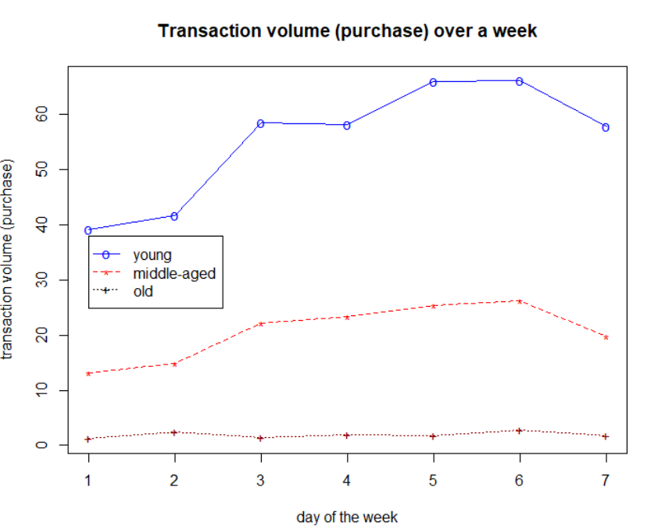
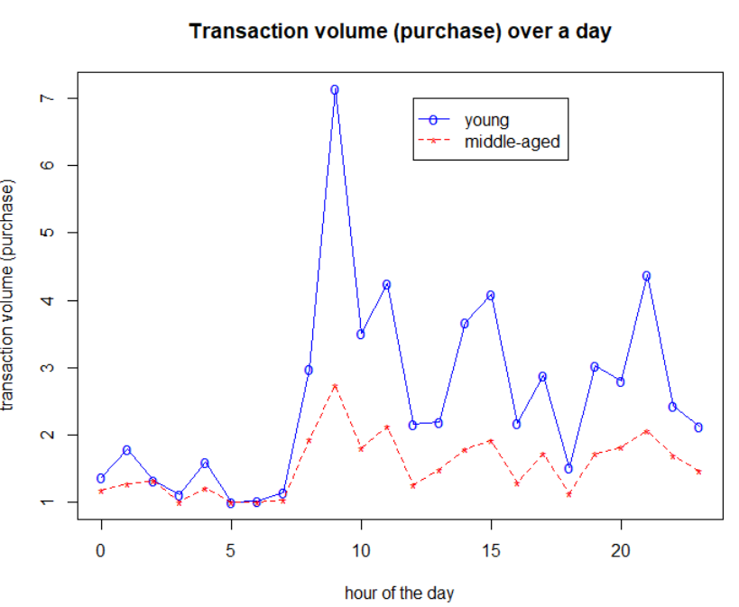
POS transaction analysis by age group
Young adults (18-35 years old) Middle-aged adults(36-55) Older adults (>55)
POS transaction volume is highest on Friday and Saturday for both young adults and middle-aged customers
POS transaction is also highest at 9:00 for both young and middle-aged customers

Slide 6
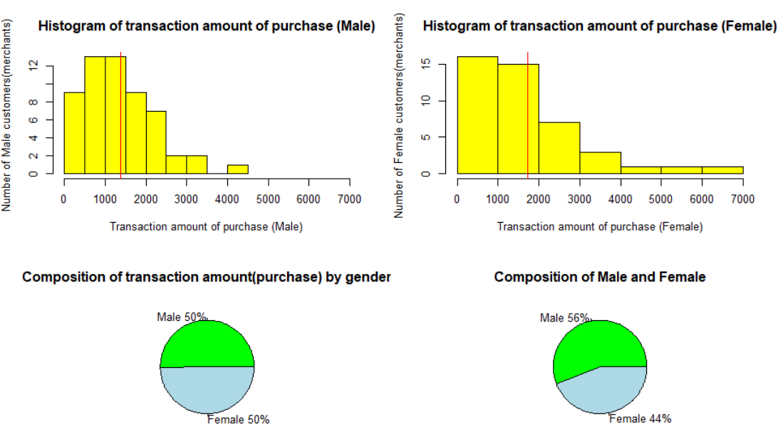
POS transaction analysis by gender
Interestingly, despite a larger composition of male, the total transaction amount of POS is almost equal for both gender
This can be explained by the histogram (red vertical line) whereby on average the amount spend on purchase for each female customer is higher than male

Slide 7
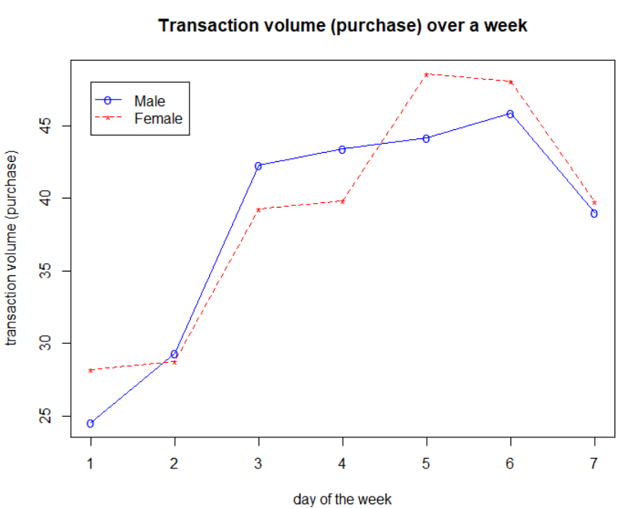
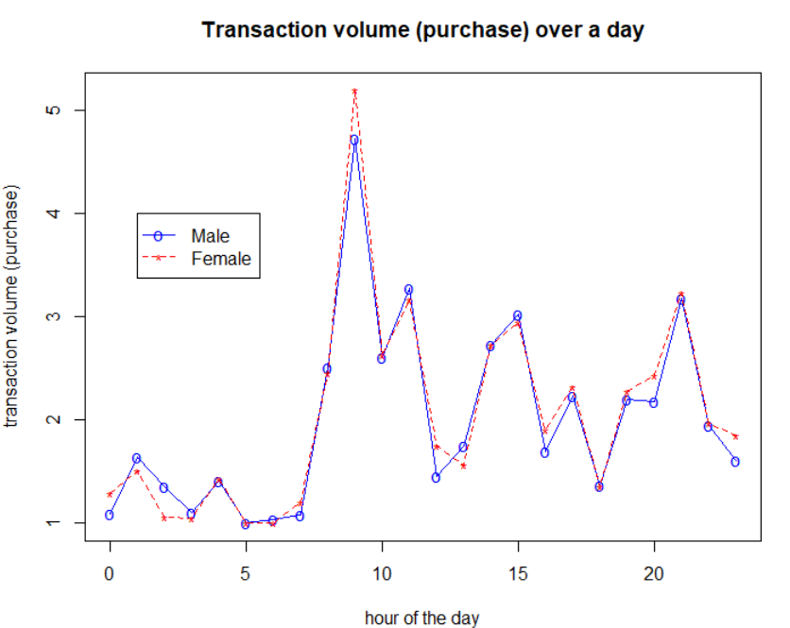
POS transaction analysis by gender
Interestingly, the highest POS transaction volume is seen on Friday for female customers. On the other hand the highest POS transaction volume is seen on Saturday for male customers
POS transaction volume is also higher for male than female customers on Wednesday and Thursday as seen by the blue line above the red on those 2 days
Both genders have highest POS transaction volume at about 9:00 of the day

Slide 8
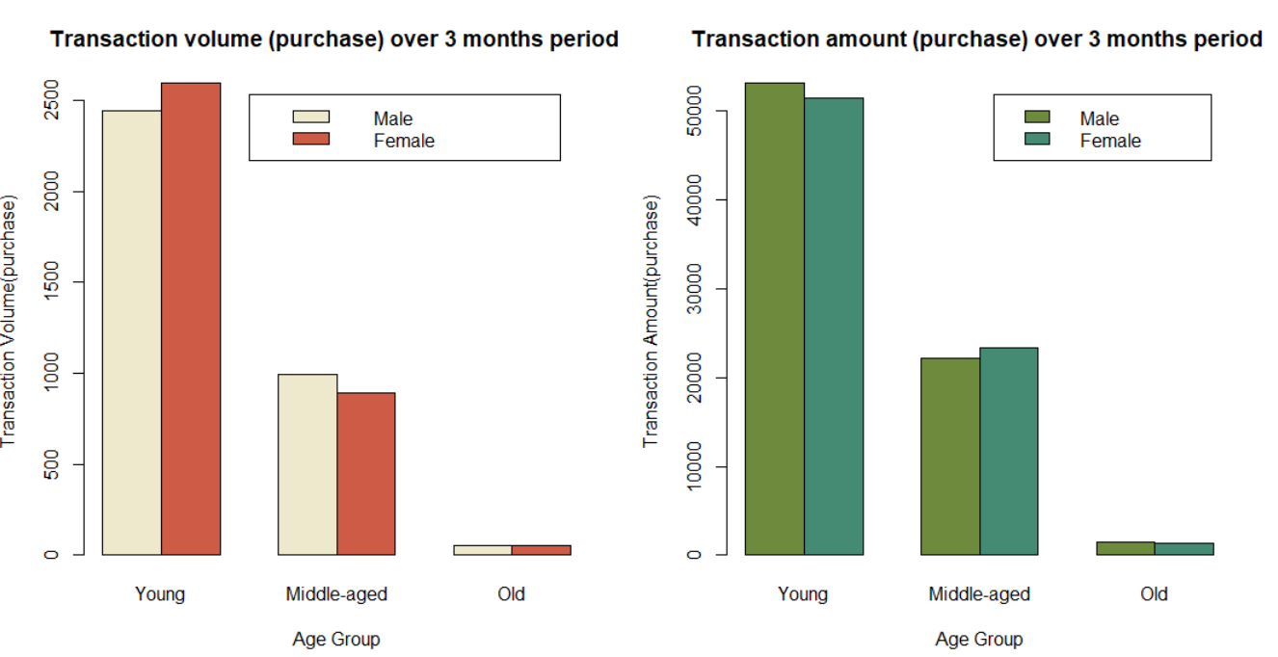
POS transaction analysis by age group and gender
Interestingly, in the younger age group, female have a higher POS transaction volume however in the middle-aged group, a higher POS transaction volume is observed in male customers
In contrast, the POS transaction amount is higher for younger male customer and lower for middle-aged male customers than female customers

Slide 9
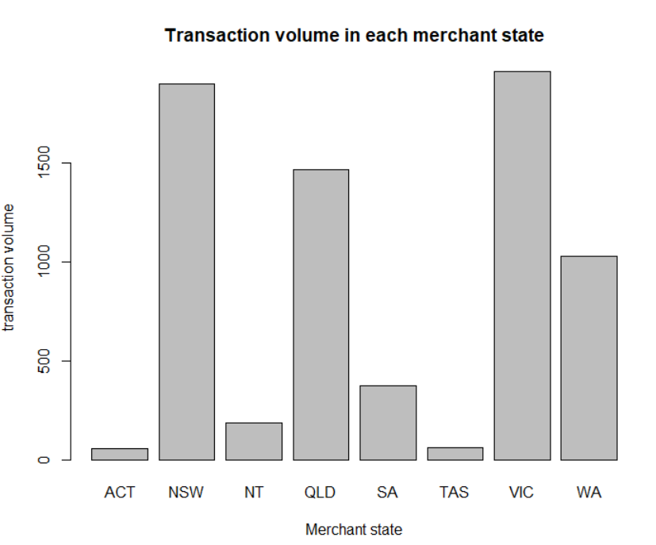
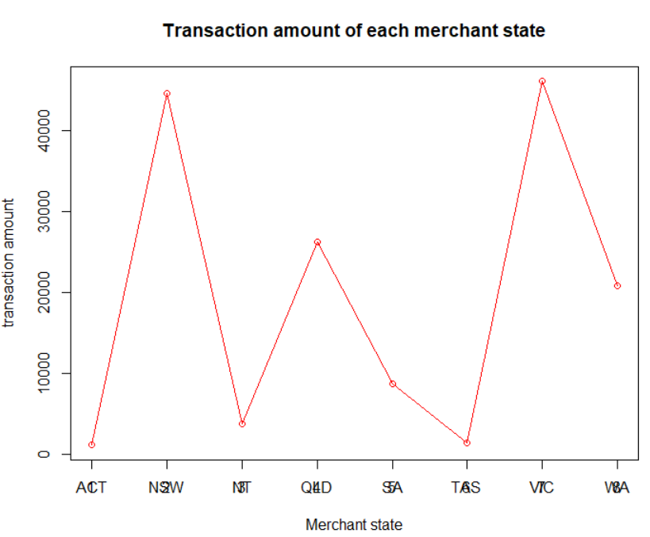
Location analysis
Transaction volumes and amount are the highest in NSW and VIC

